Slide 1
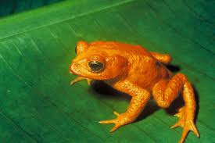
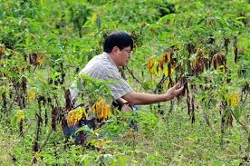
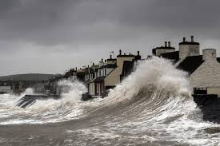
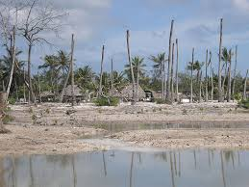
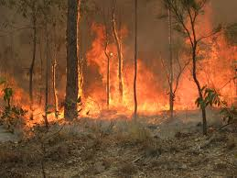
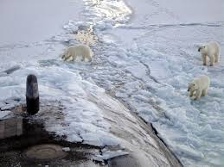
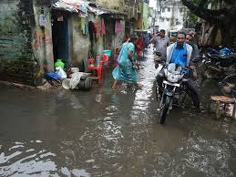
Unit 4: Major Environmental Issues
Global Climate Change

Slide 2
Summary
Introduction-some facts
Historical climate data
Global Temperature Models
The Greenhouse effect
Global warming
Climate Change initiatives
Case studies- Climate Change

Slide 3
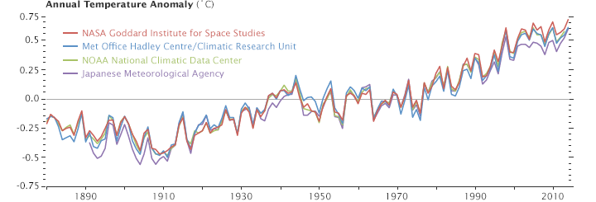
Some Facts…
The global average surface temperature has increased over the 20th century by about 0.6°C (IPCC).

Slide 4
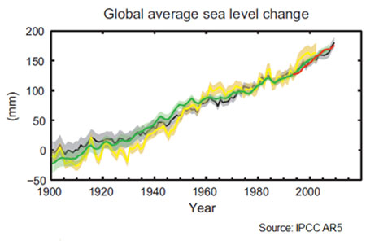
Some Facts…
The global average sea level rose by 0.19 m (IPCC)

Slide 5
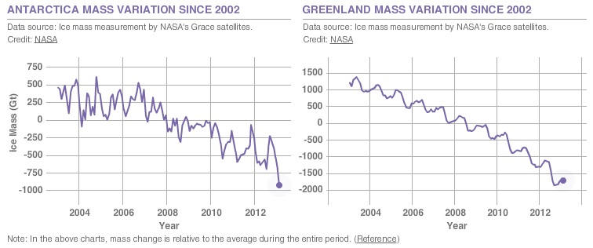
Some Facts…
There is a significant reduction in glacial mass in poles.
An iceberg of the size of the state of Delaware split off from Antarctica’s Larsen C ice shelf- NASA reported on 12 July 2017

Slide 6
Who updates the climate information?
Meteorological stations (local scale)
Tamil Nadu Agriculture University (TNAU)
Satellite images
Global agencies
IPCC (Intergovernmental Panel on Climate Change)
NASA (National Aeronautics and Space Administration)
JMA (Japan Meteorological Agency)
IMD (India Meteorological Department)

Slide 7
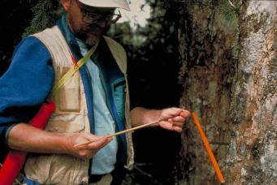
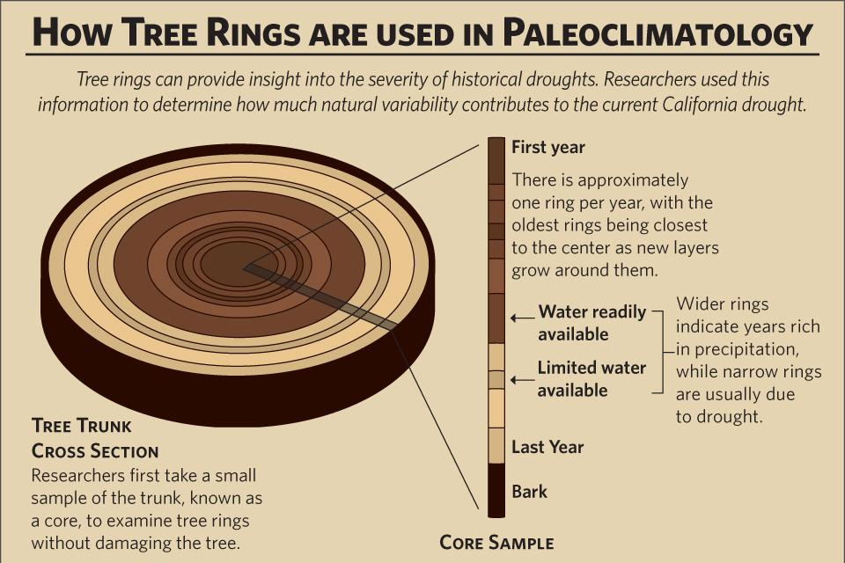
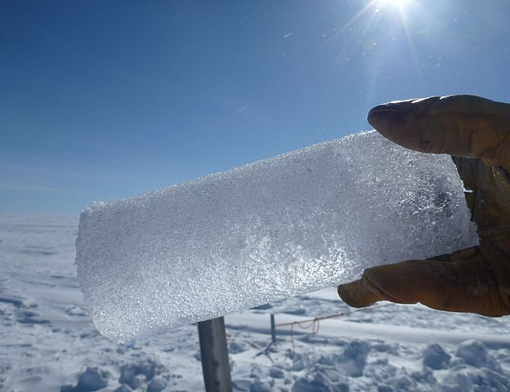
Historical climate data
Climatologists collect historical temperature data
using different methods:
Tree rings
Changes in ice volume and sea level
Fossil pollen analysis
Glacial movements

Slide 8
Historical climate data…
One of the most fruitful approaches to record global temperatures involves an observed correlation between the world’s ice cover and concentration of the isotope O¹⁸ in seafloor sediments.
When water evaporates from the oceans it contains a mix of two isotopes O¹⁶ and O¹⁸.
O¹⁸ being heavier, water vapor containing O¹⁸ condenses and falls as precipitation somewhat sooner than water vapor containing O¹⁶.
Thus Precipitation over ocean tends to be slightly richer in O¹⁸ than precipitation that must travel further to reach polar ice sheets.
Precipitation that forms glaciers and ice sheets are relatively depleted of O¹⁸.

Slide 9
Historical climate data
As the world’s ice increases, it selectively removes O¹⁶ from the H₂O cycle and concentrates the remaining O¹⁸ in the oceans.
Due to this marine organisms that build their shells out of calcium carbonate in seawater will have higher ratio of O¹⁸ to O¹⁶ in their shells when it is cold and more of the world’s water is locked up in the glaciers and ice.
By dating marine sediments and observing the ratio of the two oxygen isotopes in their carbonates, a historic thermometer can be created.
By careful analysis of the isotope ratios in the Vostok ice core (a 2083 m long ice core recovered by the Soviets at Vostok in East Antarctica) a continuous 160,000 year temperature record is obtained.

Slide 10
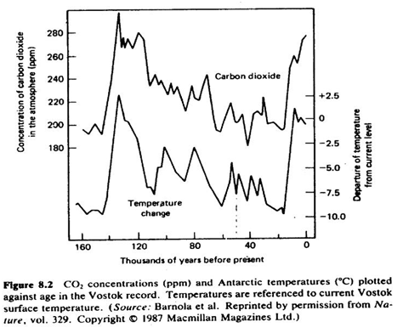

Slide 11
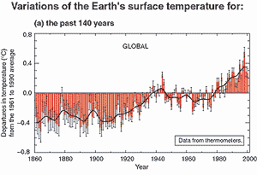

Slide 12
Historical climate data..
Historical record of global temperature shows a primary cycle between glacial episodes of about 100 000 years mixed with a periods of 23 000 years and 41 000 years
The 100 000 years cycle is accounted with change in shape of earth’s orbit from elliptical to circle
23 000 year cycle is associated with the precession or wobble of earth’s spin axis
41 000 years cycle is related to earth’s tilt.

Slide 13
Global Temperature Models
Earth as a Black body
This model predicts a global average temperature of 279 K (remarkably close to 288 K (15°C), actual global average temperature.
Unfortunately this is a coincidence.

Slide 14
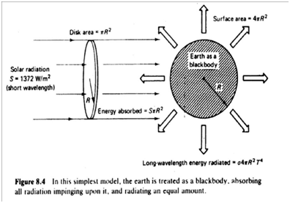

Slide 15
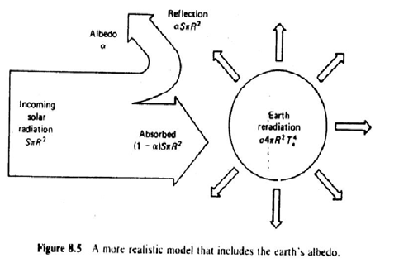

Slide 16
Simple radiation balance model that includes Earth’s Albedo
The fraction of solar radiation that is reflected is known as albedo (30 % for earth)
With this model the global average temperature is 255K! (it has worsened the situation)
What’s Wrong?

Slide 17
The Green House Effect
The surface of earth is 33°C higher than what is predicted.
Solar energy is short wavelength (less than 4 µm)
Energy radiated from Earth’s surface is long wavelength thermal radiation (more than 4 µm)

Slide 18
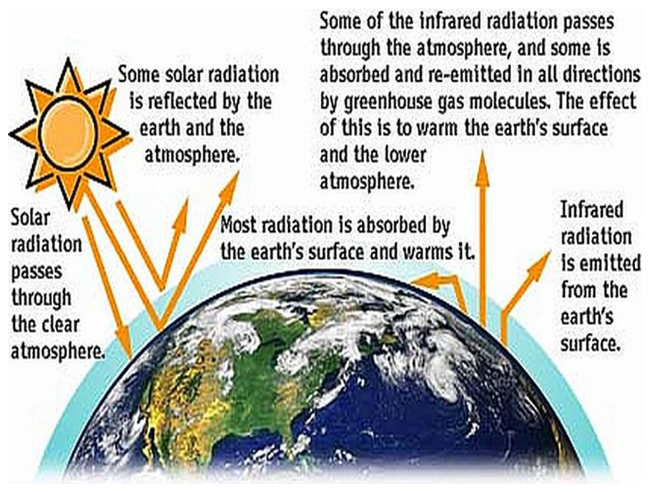
Green House Effect

Slide 19
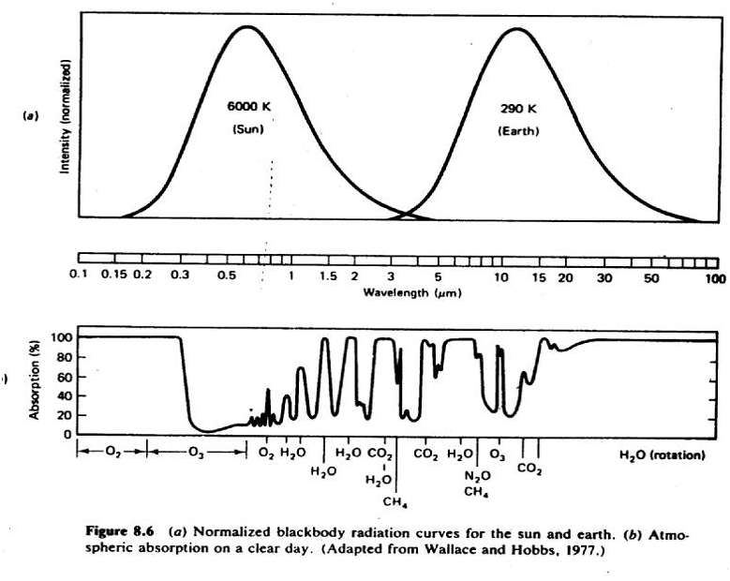

Slide 20
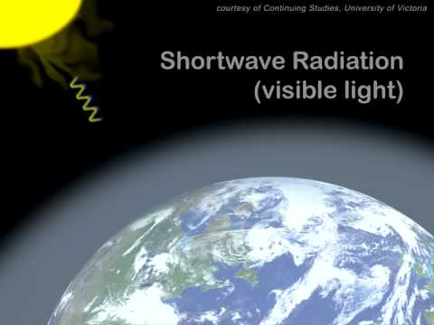
The Green House Effect
Most of the long wavelength radiations are absorbed by green house gases like water vapor, carbon dioxide, nitrous oxide and methane.
These greenhouse gases act as a thermal blanket around the globe, raising the earth’s temperature beyond the equivalent calculated temperature (this accounts for the 33°C)
Video: CO₂ and the Greenhouse Effect (8 min)

Slide 21
Greenhouse effect enhancement and consequences
Anthropogenic sources of a number of gases are enhancing the green house effect resulting in Global Warming
Calculations indicate that a rise in sea level of about ¼ m per degree Celsius.
A total rise of 1-3 m is projected by the end of next century.

Slide 22
Carbon dioxide
Global temperature is found to have close relation with presence of carbon dioxide in the atmosphere.
1 ppm of CO2 = 2.12 giga ton CO2
At the beginning of 19th century the concentration of carbon dioxide was around of 280 ppm.
Present value of carbon dioxide is around 324 ppm.
If an exponential growth is modeled, the carbon dioxide level will be 560 ppm by 2100!!

Slide 23
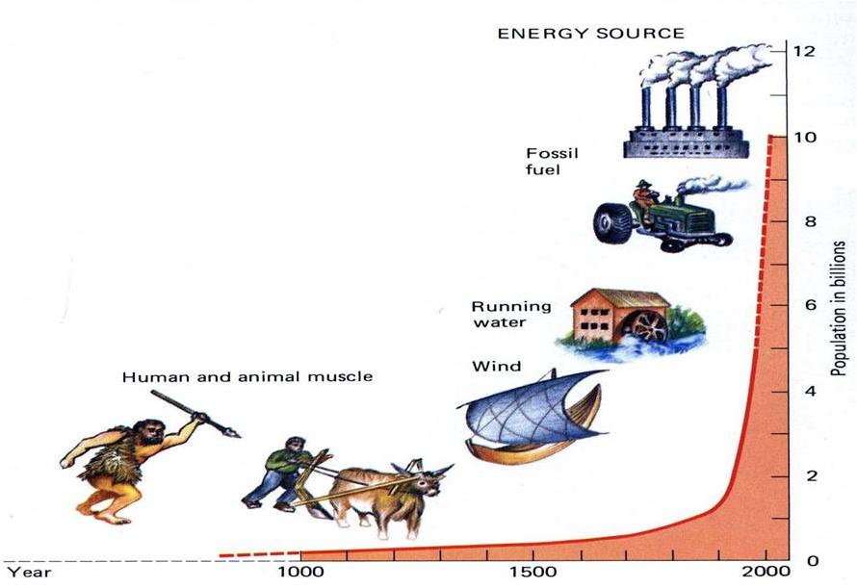
Worlds Changing Scenario

Slide 24
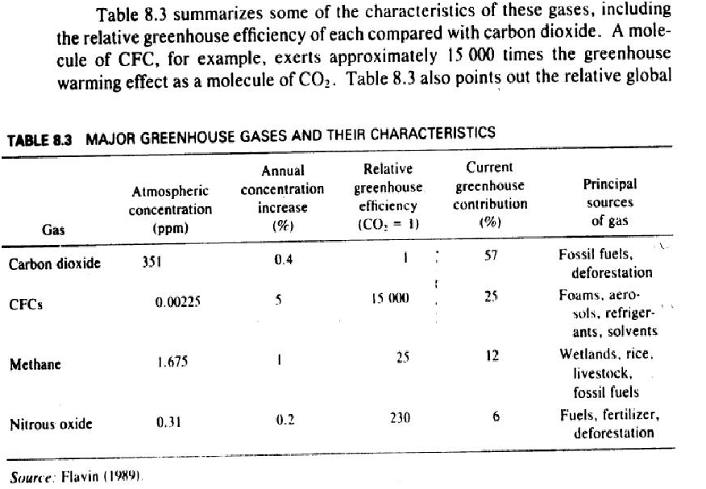

Slide 25
Are human activities modifying the atmosphere?
The atmospheric concentration of carbon dioxide (CO₂) has increased by 31% since 1750 .
"The atmospheric concentration of methane (CH₄) has increased by 151% since 1750 and continues to increase
The atmospheric concentration of nitrous oxide (N₂O) has increased by 17% since 1750 and continues to increase.
Snow cover and ice extent have decreased by about 10% when compared to 1960.

Slide 26
Chlorofluorocarbons
These are molecules that contain chlorine, fluorine and carbon
Their presence in the atmosphere is entirely due to human activities.
These molecules are inert and non water soluble, so they are not destroyed through chemical reactions or removed with precipitation.

Slide 27
Global warming and Ozone –Depletion impacts of CFCs
Fully halogenated CFCs have long atmospheric lifetimes,contain relatively large amounts of chlorine, and can absorb strongly within the 7 to 13 µm atmospheric window
Therefore, they have considerable potential for global warming and ozone depletion.
They are 15000 times potent than carbon dioxide

Slide 28
Other Greenhouse Gases 1. Methane
Naturally occurring
Increasing due to human activities
Significant increase due to food-growing activities, cattle production
It is also released during production, transportation and consumption of fossil fuels
It absorbs at about 7.66 micrometer and 25 times as potent as carbon dioxide in global warming.

Slide 29
Other Greenhouse Gases 2. Ozone
About 90% of Ozone resides in the stratosphere
It protects us from UV radiations
Increase in the Troposphere ozone can contribute to raising global temperature

Slide 30
Other Greenhouse Gases 3. Nitrous Oxide
Released into the atmosphere mostly during the nitrification portion of the nitrogen cycle.
Combustion of fossil fuels and nitrogen fertilizer are the two major human activities that release this to the atmosphere
It has strong absorption bands at 4,5,7,8 and 17 micrometer and it is about 280 times potent as carbon dioxide in causing global warming.

Slide 31
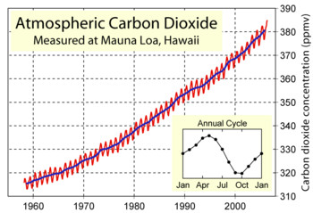
Global warming
Increase in carbon dioxide emissions
The Keeling Graph

Slide 32
IPCC 2014 Reports:
“Warming of the climate system is unequivocal. It is extremely likely that human influence has been the dominant cause of observed warming since 1950”.
“…the longer we wait to reduce our emissions, the more expensive it will become” .

Slide 33
GLOBAL WARMING
Impact of high use of energy
Worldwide repercussions
Natural hazards
Droughts and floods
Sea-level rise
Spread of infectious diseases
Is global warming occurring?

Slide 34
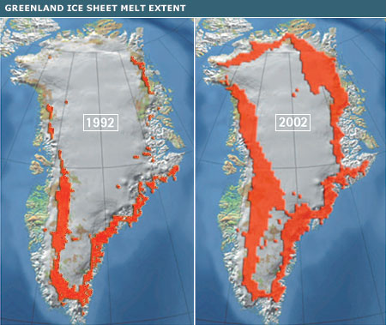

Slide 35
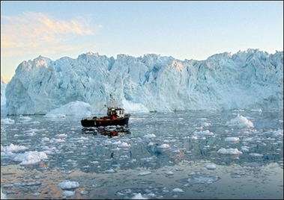

Slide 36
WORLD SCIENTISTS’ WARNING TO HUMANITY (1992)
1670 distinguished scientists (including 104 Nobel Laureates) said:
“Human Beings and the natural world are on a collision course”
“We must move away from fossil fuels to cut greenhouse gas emissions”

Slide 37
INTERGOVERNMENTAL PANEL ON CLIMATE CHANGE (IPCC)
Set up in 1988 by World Meteorological Organization (WMO) to assess the science related to climate change
Currently has 195 member countries
IPCC provides scientific and intergovernmental based outlook to develop climate related policies
See also: http://www.ipcc.ch/

Slide 38
IPCC REPORT
Authors are eminent scientists from all over the globe grouped into 3 working group (WG)
WG-1: Physical Science Basis
WG-2:Impacts, Adaptation and Vulnerability, and
WG-3: Mitigation of Climate Change & the Task Force on National Greenhouse Gas Inventories (TFI)

Slide 39
United Nations Framework Convention on Climate Change
UNFCCC is one of the ramifications of the Rio Earth Summit 1992, started its function in 1994
Currently it is having 197 (countries) parties to the convention
The ultimate objective of UNFCCC:
“..stabilization of greenhouse gas concentrations in the atmosphere at a level that would prevent dangerous anthropogenic interference with the climate system…”

Slide 40
Responses to Climate Change
As per UNFCCC, two fundamental response strategies to tackle Climate Change
Adaptation:
“refers to adjustment in natural or human systems in response to actual or expected climatic stimuli or their effects, which moderates harm or exploits beneficial opportunities”.
Mitigation:
“refers to implementing policies to reduce GHG emissions and enhance sinks and technological change and substitution that reduce resource inputs and emissions”.

Slide 41
THE KYOTO PACT
Kyoto Pact is an UNFCCC agreement commits its Parties by CO₂ emission reduction targets
Came into force on 16.2.2005
First commitment period 2008-2012
CO₂ emission reduction Target→5% in industrial nations 7% in US, below 1990 levels
Second commitment period January 2013 to 31 December 2020
Target: GHG emissions by at least 18% below 1990 levels

Slide 42
PARIS PACT
UNFCC conference of parties (COP 21) held in Paris 2015
Aim is to strengthen the global response to the threat of climate change
Reaffirms the goal of keeping average warming below 2 degrees Celsius, also urging parties (highly vulnerable developing countries) to “pursue efforts” to limit it to 1.5 degrees
“Prepare, communicate and maintain” a NDC (Nationally Determined Contributions) by parties

Slide 43
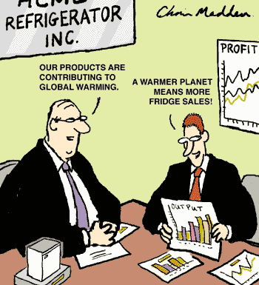

Slide 44
Impacts of Climate change and global warming
Climate change could kill up to 180 million people in Africa
150,000 people already die every year from climate change
Source: World Health Organisation
100 million more people will be flooded by end of century
30 million more people may be hungry because of climate change by 2050
Source: The Hadley Centre
Rising sea levels and crop failures could create 150 million refugees by 2100

Slide 45

Impacts of Climate change and global warming
Warmer land and waters and rising sea levels are detrimental to sensitive ecosystems.
The rate of sea level rise over the Bay of Bengal is at the rate 0.75–6 mm/year (IITM, Pune 2016)
Many unique habitat in India under threat Eg: Sundarbans, world’s largest mangrove forest, that abode Bengal tigers and many faunal sps.

Slide 46
Impacts of Climate change
and global warming
Mass death of coral reefs because of coral bleaching widely reported in the recent past across the world is attributed to Global warming .
The research have noted that 1700 plants, animals and insects species moved pole wards at an average rate about 4 miles per decade in the last half of the 20th Century.
Over the past 25 years, penguin populations have shrunk by 33 percent in parts of Antarctica, due to declines in winter sea-ice habitat.

Slide 47
Impacts of Climate change
and global warming
According to a new global study 90 percent of all large fishes have disappeared from the world's oceans in the past half century.
The golden toad (Bufo periglenes) of Costa Rica has disappeared as a direct result of global warming.
Oil from wells unable to meet demand, massive disruptions in transportation & economy, not enough time to switch to renewables

Slide 48
Climate Change and Global Warming - India
-Unpredictability in monsoon rains, which India’s agriculture is heavily dependent on
-Temperature rise of between 2 and 3.5 degrees centigrade, would cost India a loss of between 9 and 25 percent of total agricultural revenue
-Melting glaciers will affect one-sixth of the world's population residing mainly in the Indian subcontinent.

Slide 49
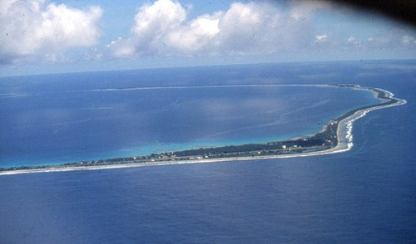
Climate Change impacts- Case Studies

Slide 50
Tuvalu Islands
Chain of nine coral islands in the South Pacific
Small, remote islands between Hawaii and Australia.
Area of 25 sq km and a population of 11,000
Paradise with chalk-white beaches and coconut palms.
The problem:
Islands located at low levels.
Most houses are just three metres above sea level.

Slide 51
Tuvalu: First victim of global warming?
Sea level rise already a fact
Salt water flowing up through porous fossil ground
Traditional root crop, Pulaka, affected
Tides are higher and the storms are more frequent and severe
Crops and plantations are being destroyed by salt water
People migrating to New Zealand,
Tuvalu plans to file a case against industrialized countries in International Court of Justice.

Slide 52
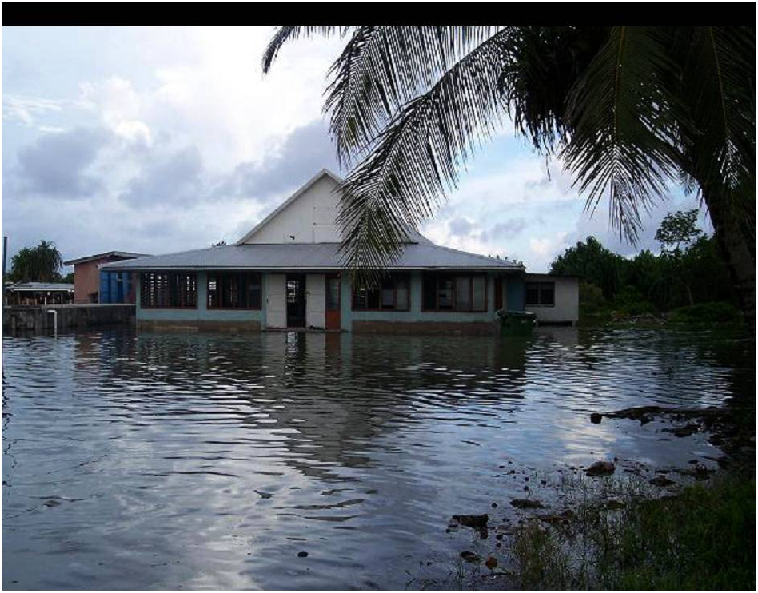
Who doesn’t want a house with a swimming pool? How about a house IN a swimming pool?

Slide 53
Tuvalu is far away.
We are still safe.
It will not happen everywhere.
Is it true ?

Slide 54
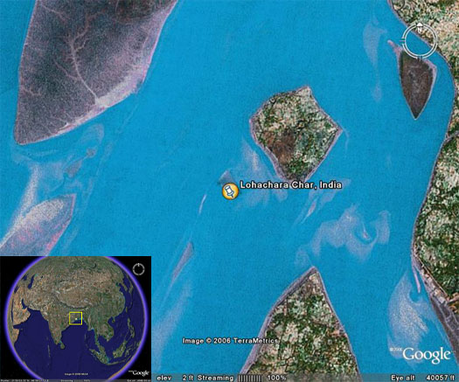

Slide 55
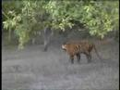
Sinking islands of the Sundarbans
Coastal area of India and Bangladesh
Island of Lohachara (10,000 people) has disappeared.
Ghoramara: two-thirds gone
8 more islands likely to sink
70,000 people have to move
400 tigers in peril
Video: Sundarbans- Future Imperfect (10 min)

Slide 56
